Slide 1
HTML5 SEMANTIC ELEMENTS
A semantic element clearly describes its meaning to both the browser and the developer.
<img> , <form> , <table> i.e. these elements define its contents clearly.
Non-semantic elements generally tells nothing much about its content.
Traditionally developers have implemented non-semantic elements with a class attribute to define the structure and express the meaning of content.
Examples of non-semantics elements are : <div> and <span> i.e. these elements tells nothing about its content.

Slide 2
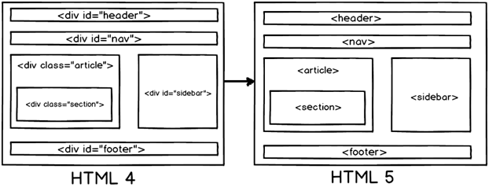
HTML4 AND HTML5 COMPARISON

Slide 3
Why Semantic Elements?
HTML5 semantic elements help structure the code we
create, and therefore making it more readable and easier to maintain.

Slide 4
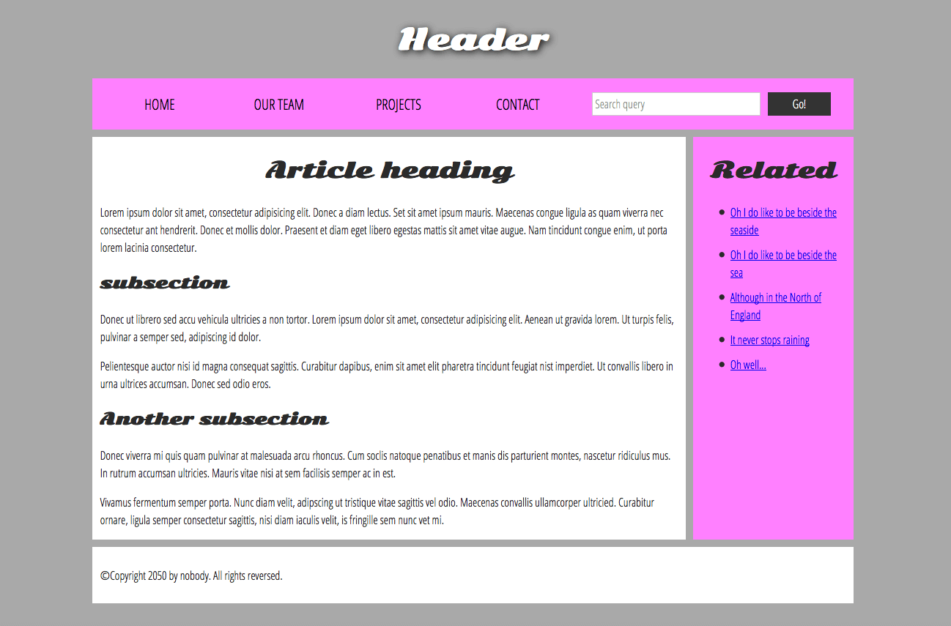

Slide 5
The Separation of Style, Content and Behavior
Core Concept of web development
HTML + CSS + JavaScript
Content + Style + Behavior
CSS is a rule-based language — you define rules specifying groups of styles that should be applied to particular elements or groups of elements on your web page.
Notes:
This is the core concept of not just CSS, but web development in general. In a lot of ways it’s taken for granted now, but it wasn’t always so.

Slide 6
Our New HTML
<h1>Fancy Lads</h1>
<p>Welcome to The Fancy lad Site!</p>
<p>This web-page is the semi-official home of Fancy lads on the World Wide Web.</p>
<!--How much simpler is that?→
<p align="center">
<font face="Papyrus"><img border="0" src=“fancy-header.png” width="207" height="279"></font>
</p>
<p align="center">
<font face="Papyrus“> Welcome to The Fancy lad Site!</font>
</p>
<p align="center">
<font face="Papyrus">This web-page is the semi-official home of Fancylads on the World Wide Web.</font>
</p>
Notes:
And this is a simpler example to start with. With the real tag soup pages you could cut out probably 70% of the markup. Don’t worry if none of this makes perfect sense yet. It’s there just to illustrate how much markup CSS can save.

Slide 7
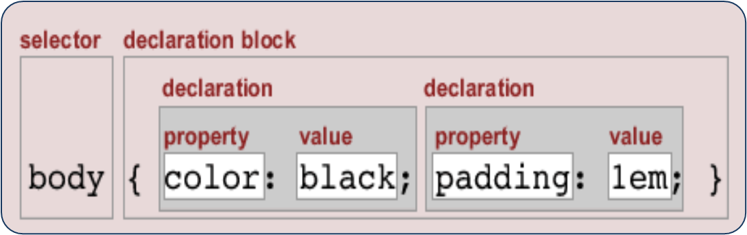
Let’s See the Associated Style Sheet
h1{
background:url(fancy-header.png) no-repeat;
width:207px;
height:279px;
text-indent:-9999px;
}
p {
text-align:center;
font-family:papyrus;
}
Notes:
And here’s where all that info goes.

Slide 8

Selector that directly matches an HTML element name.
Target multiple selectors at once, by separating the selectors with a comma.
p, li { color: green; }
Changing the default behavior of elements
li { list-style-type: none; }
To select a subset of the elements without changing the others.
.special { color: orange; font-weight: bold; }
li.special { color: orange; font-weight: bold; }

Slide 9
descendant combinator
li em { color: rebeccapurple; }
adjacent sibling combinator)
h1 + p { font-size: 200%; }
Styling things based on state
a:link { color: pink; } a:visited { color: green; }

Slide 10

article p span { ... }
selects any <span> that is inside a <p>, which is inside an <article>
h1 + ul + p { ... }
selects any <p> that comes directly after a <ul>, which comes directly after an <h1>
body h1 + p .special { color: yellow; background-color: black; padding: 5px; }

Slide 11
Exercise-1
Write CSS rules that apply styling to different HTML elements:
font-size
width
background-color
color
border

Slide 12
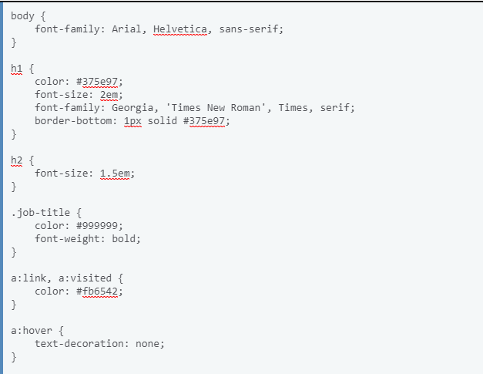
Exercise-2

